Slide 1
Metro Rail – Predictive Maintenance Based On Anomaly Detection
Group 21:
Vishal Anand Gupta
Rathil Madihalli
Sanyam Jain
Pritesh Singh
Karthick Vel

Slide 2
01
Background and Objectives
02
Data Description
03
Exploratory Data Analysis
04
Preliminary Approach
05
Autoencoders for Anomaly Detection
06
Next Steps
CONTENTS

Slide 3
01
Background and Objectives
.

Slide 4


Background and Objectives
Electronic Control Unit
Air Production Unit (APU)
Installed on the roof of metro vehicles
Feeds different units which perform different functions
Failure could cause immediate removal of train for repair
Compressor
Air
Dryer
Pneumatic
Panel
Predictive Maintenance
Project Objectives
Maintenance can be of 3 types – preventive, corrective and predictive
Preventive Maintenance leads to waste of resources while corrective maintenance waits for failure to take place
Predictive maintenance is the most optimum approach which can be used to detect anomalies and perform maintenance before the failure
Reduce unforeseen maintenance – thereby reducing the number of stops and stopping time
Change maintenance paradigm – from reactive to predictive by detecting anomalies in the data before the failure actually happens
Reduce false alarms – to make the process of maintenance more efficient and cost-effective

Slide 5
02
Data Description
.

Slide 6
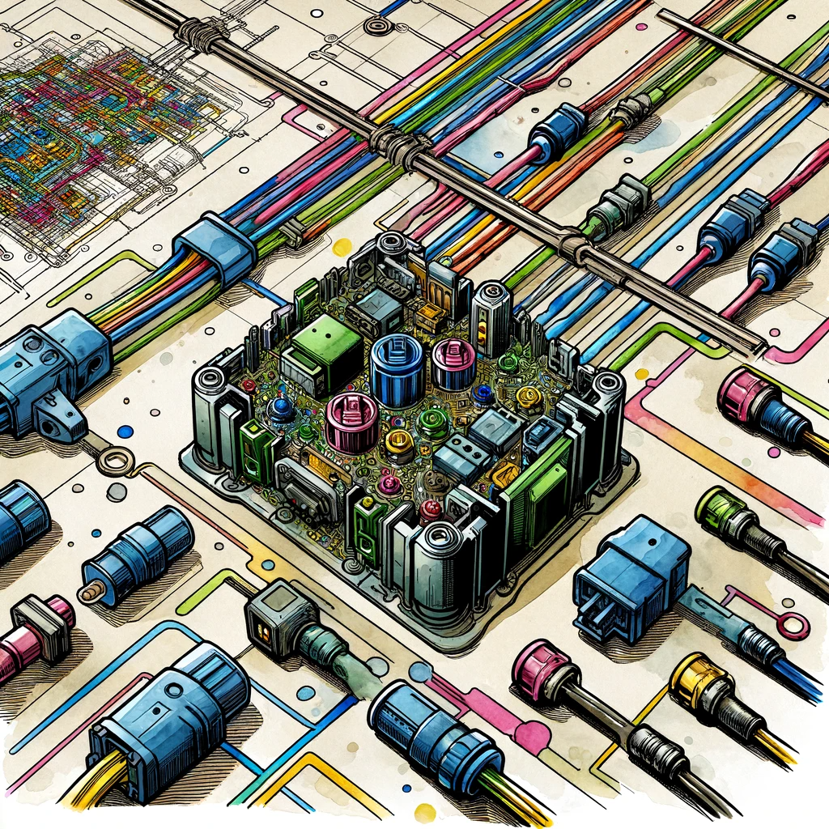
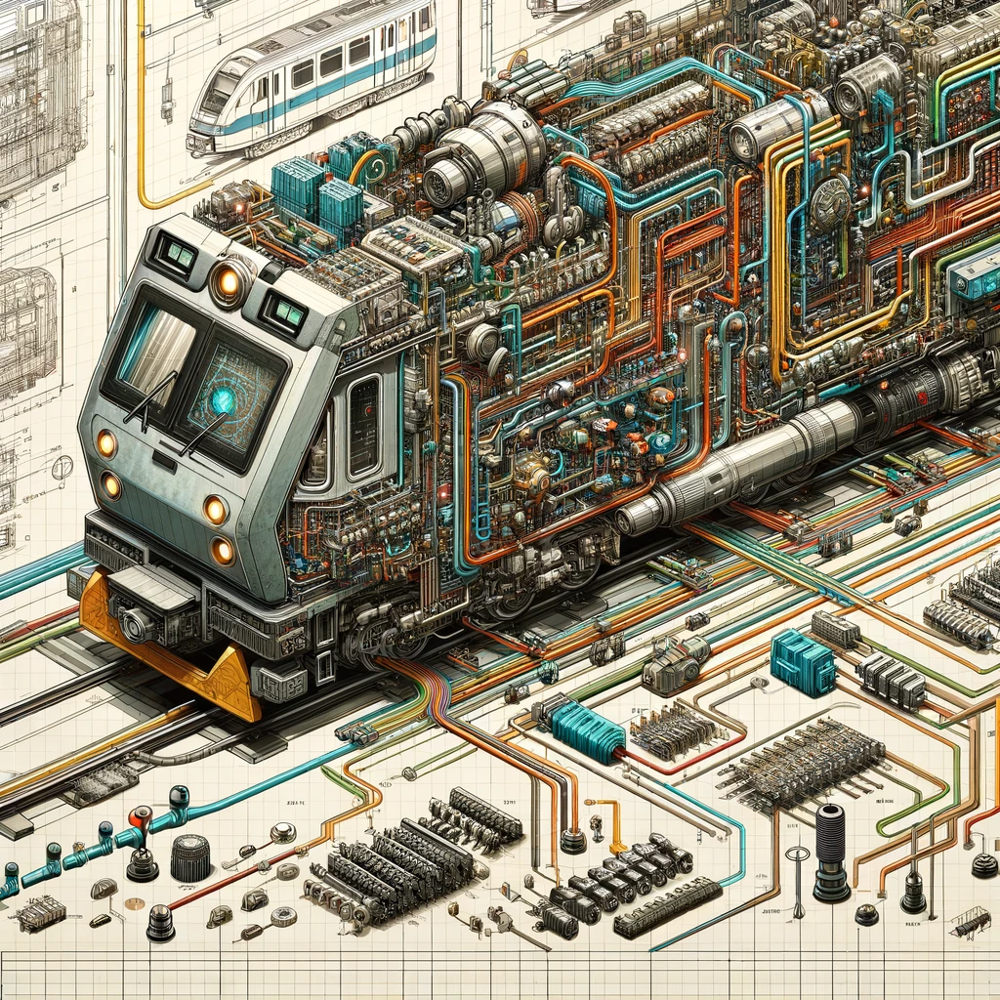
Data Description
Data Source
UCI Machine Learning Repository
Timeline
Feb’20 – Aug’20
# Records
1,516,948
Frequency
Every 10 seconds
Data corresponds to the 8 digital and 7 analog sensors connected directly with the APU.
Digital Sensors
Analog Sensors
COMP - Electrical signal of the air intake valve on the compressor
DV_electric - Electrical signal that commands the compressor outlet valve
TOWERS - Signal that defines which tower is drying the air and which tower is draining the humidity removed from the air
MPG - Is responsible for activating the intake valve to start the compressor under load when the pressure in the APU is below 8.2bar
LPS - Signal activated when the pressure is lower than 7 bars.
Pressure_switch - Signal activated when pressure is detected on the pilot control valve.
Oil_Level – Is active (equal to one) when the oil is below the expected values.
Caudal_impulses - Signal produced by the flowmeter indicating the existence of the flow of air per second.
TP2 - Pressure on the compressor (bar)
TP3 - Pressure generated at the pneumatic panel (bar)
H1 - Valve that is activated when the pressure read by the pressure switch of the command is above the operating pressure of 10.2bar
DV_pressure - Pressure exerted due to pressure drop generated when air dryers’ towers discharge the water.
Reservoirs - Pressure inside the air tanks installed on the trains (bar)
Oil_Temperature - Temperature of the oil present on the compressor (°C).
Motor_Current - Motor’s current, which should present the following values: (i) close to 0A when the compressor turns of; (ii) close to 4A when the compressor is working ofoaded; and (iii) close to 7A when the compressor is operating under load (A);

Slide 7
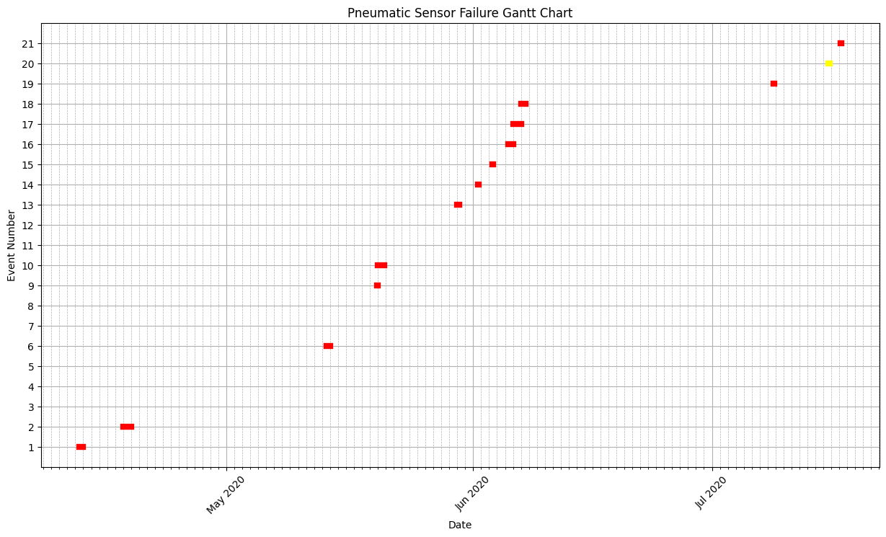
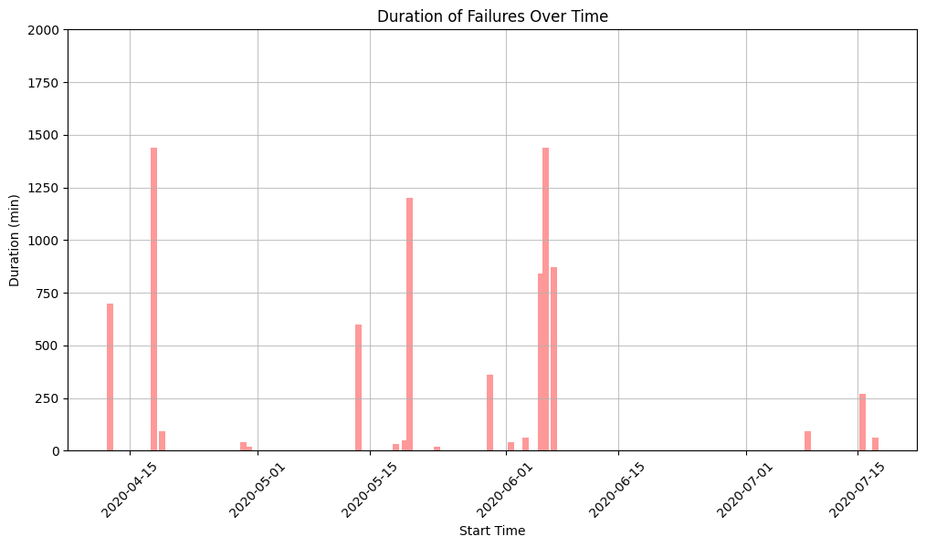
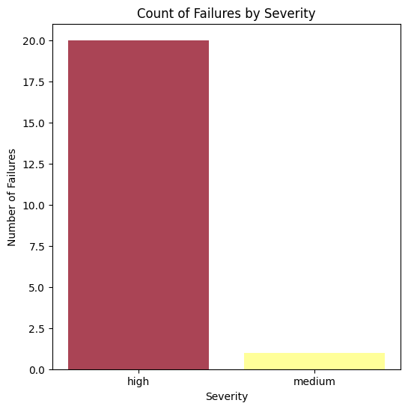
Periods of Failure
Failures are infrequent, but usually severe

Slide 8
03
Exploratory Data Analysis
Normal Day vs Failure Day Sensor Data
Leading to Failure Data

Slide 9
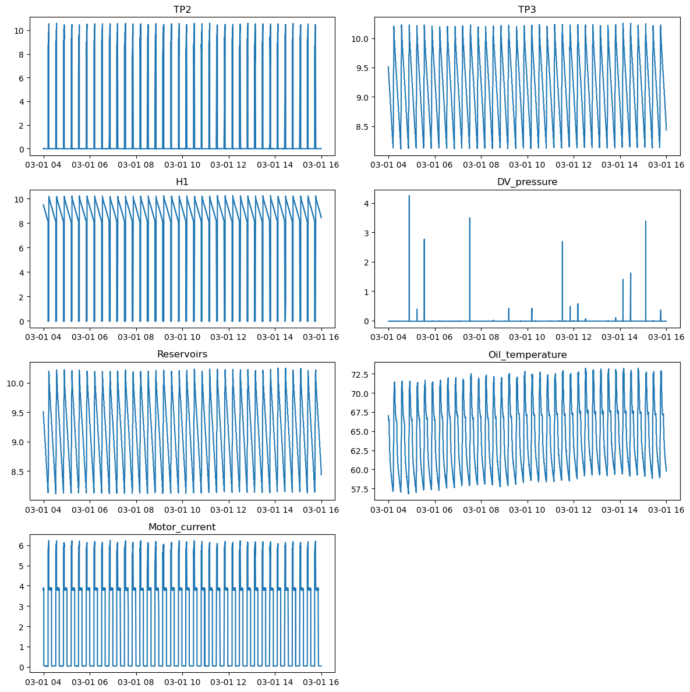
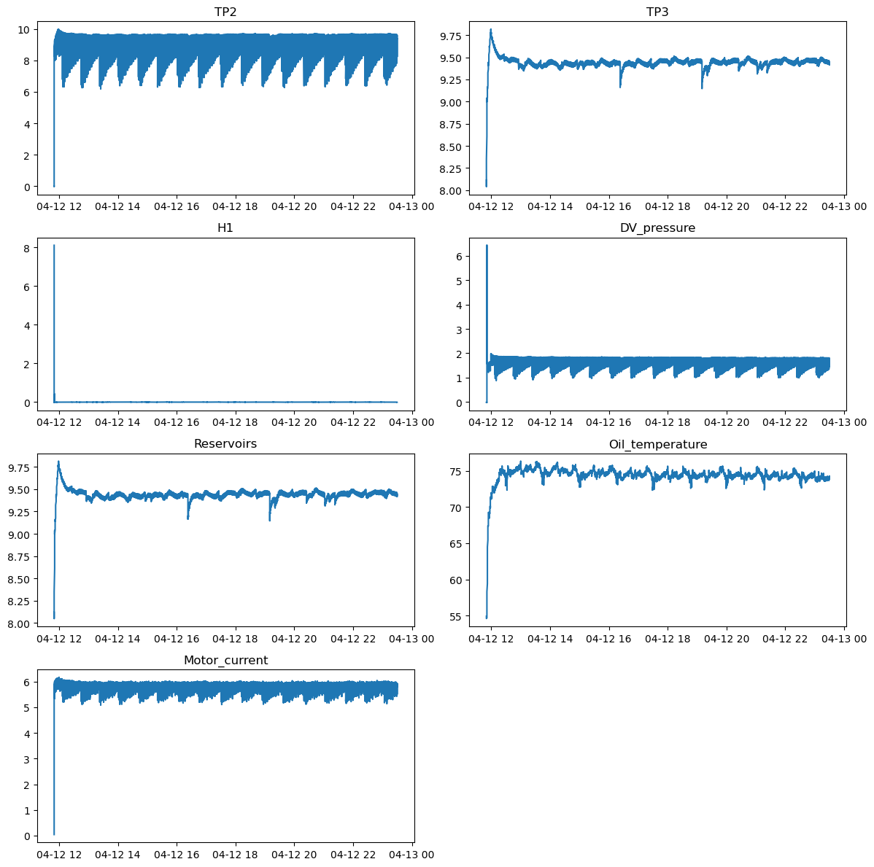
Normal Day v/s Failure Day Analog Signal Trends
Normal Day
Failure Day

Slide 10
Normal Day v/s Failure Day Analog Signal Trends
Normal Day
Failure Day

Slide 11
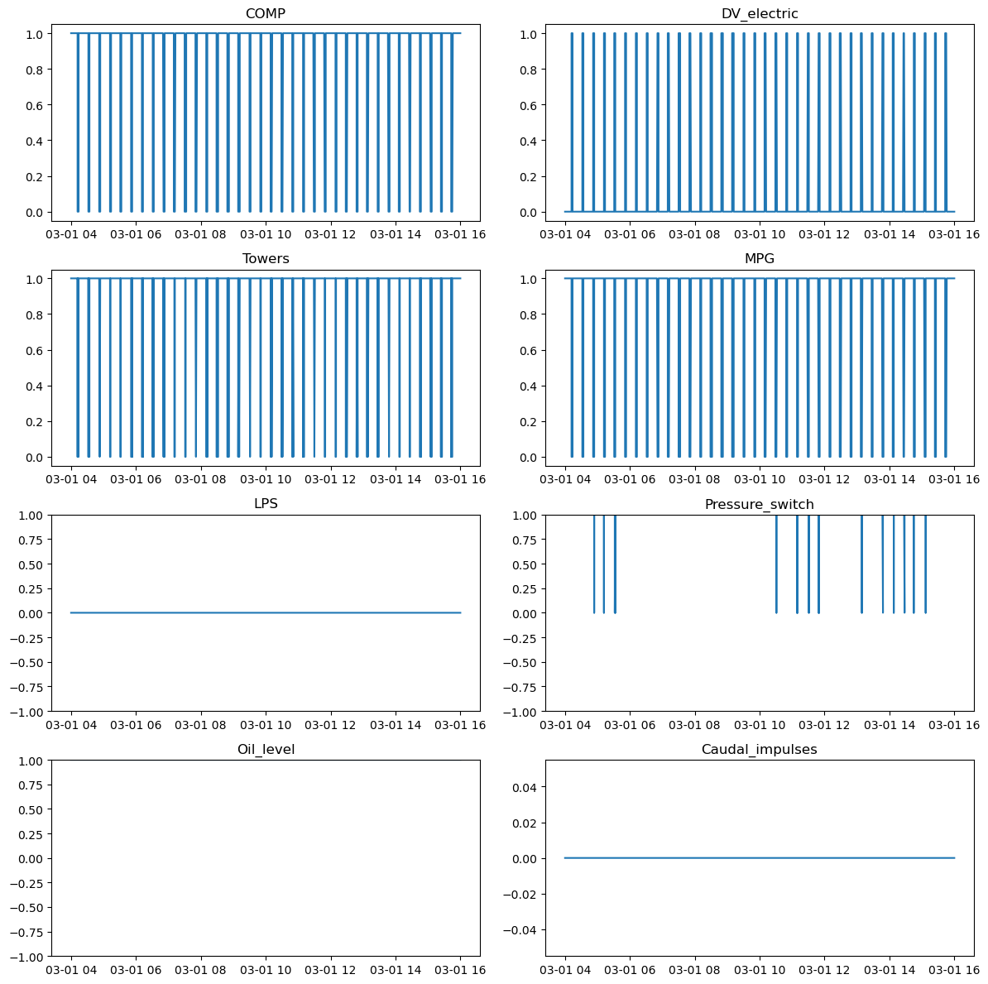
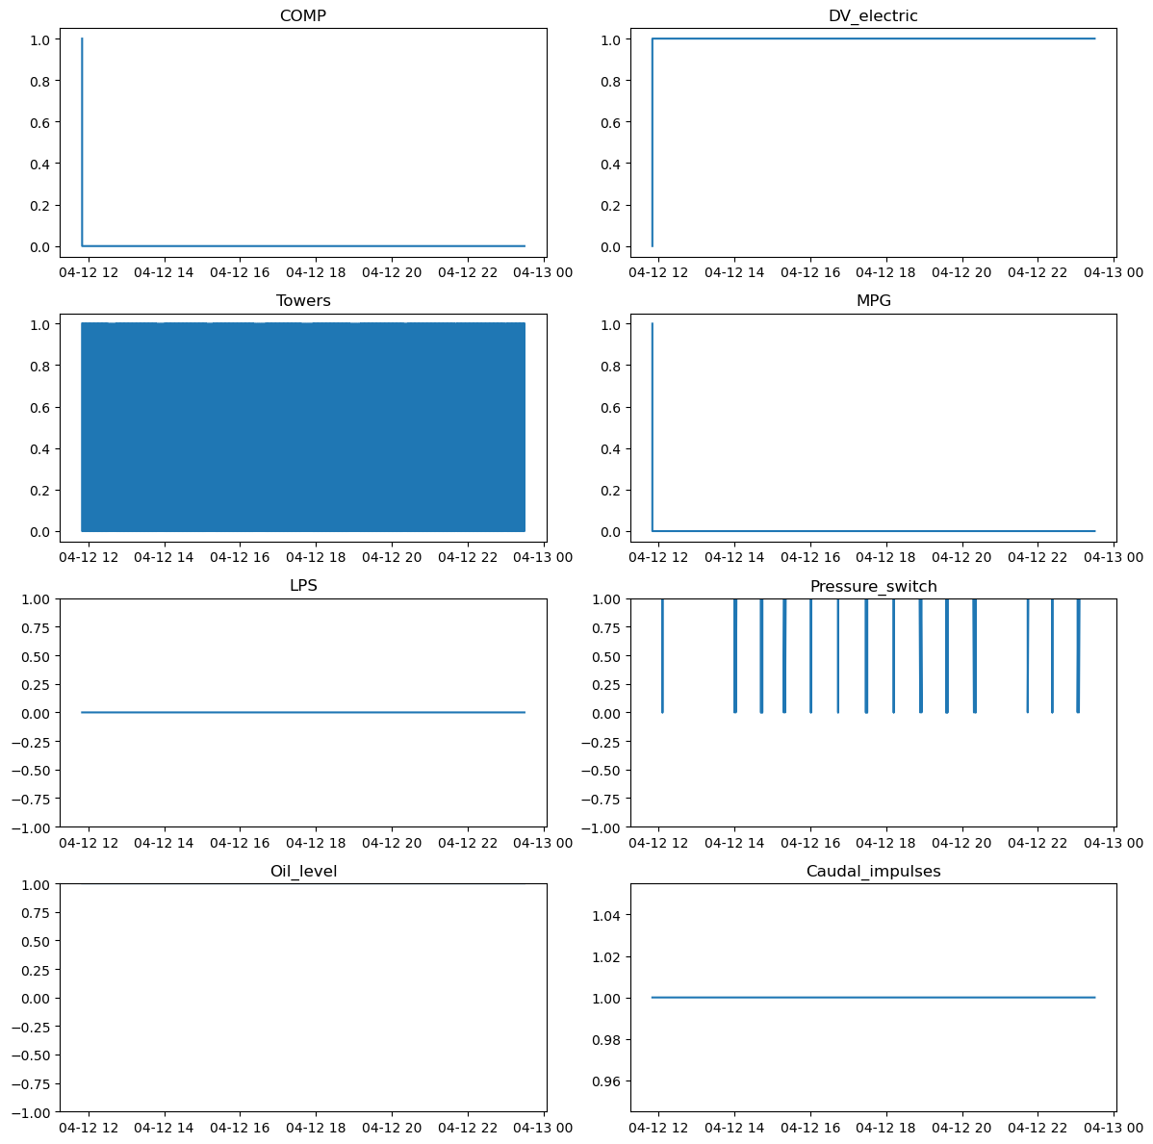
Normal Day v/s Failure Day Digital Signal Trends
Normal Day
Failure Day

Slide 12
Normal Day v/s Failure Day Digital Signal Trends
Normal Day
Failure Day

Slide 13
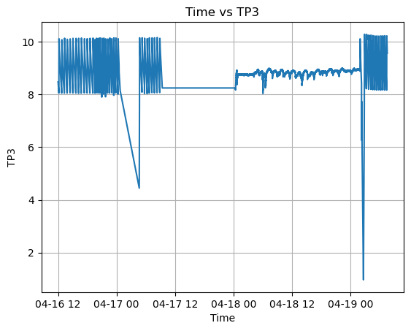
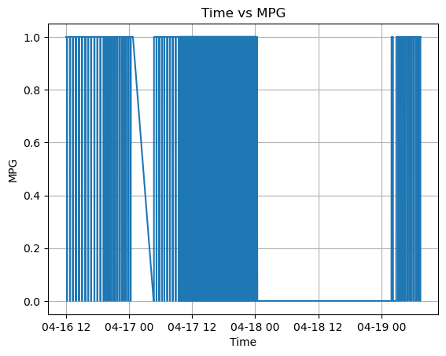
Normal Day v/s Failure Day Sensor Trends
Analog
Digital

Slide 14
04
Preliminary Approach

Slide 15
Classification Approach to Failure Detection
We have labeled data, and we have to predict failure. How difficult can it be? We can use regular classification approaches for this task.
Model | Precision | Recall | F1 Score
Decision Trees | 98.2% | 97.9% | 98.0%
Random Forest | 98.5% | 98.7% | 98.6%
Neural Network | 97.4% | 91.3% | 94.3%
Too good to be true!! What’s the catch?

Slide 16
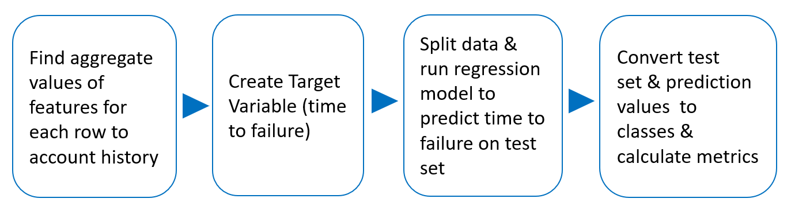
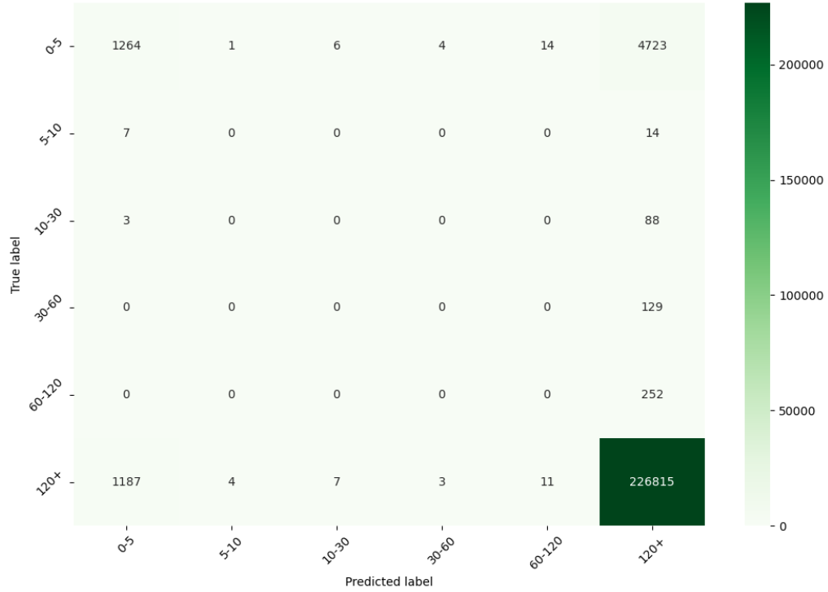
Time to Failure Approach
Process
Results
Metric | Value
RMSE(continuous) | 21867
R^2(continuous) | 0.46
Accuracy | 0.97
Precision | 0.96
Recall | 0.97
F1 | 0.96

Slide 17
05
Autoencoders for Anomaly
Detection

Slide 18
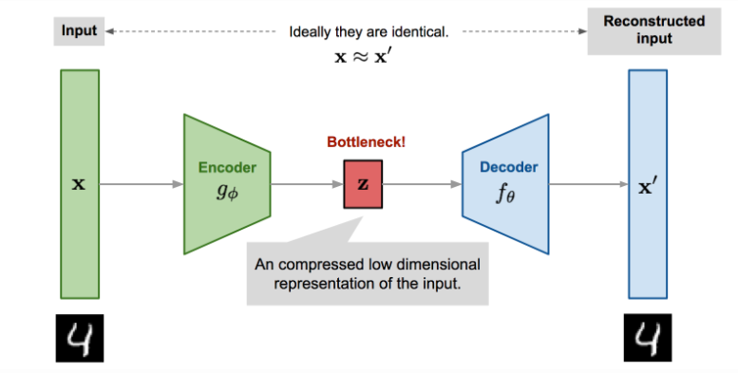
Autoencoder

Slide 19
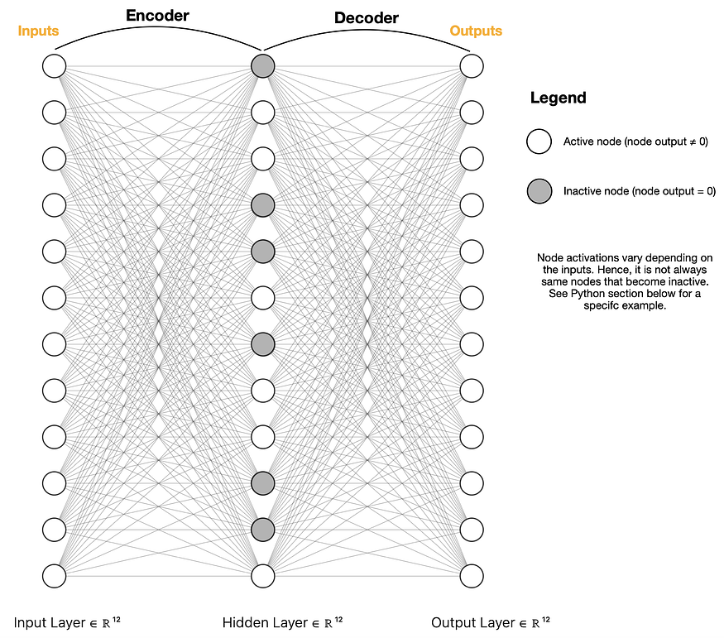
Sparse Autoencoder
Regularization item is added to the cost function for penalizing the weights
Small number of neurons are activated and trained to encode and decode

Slide 20
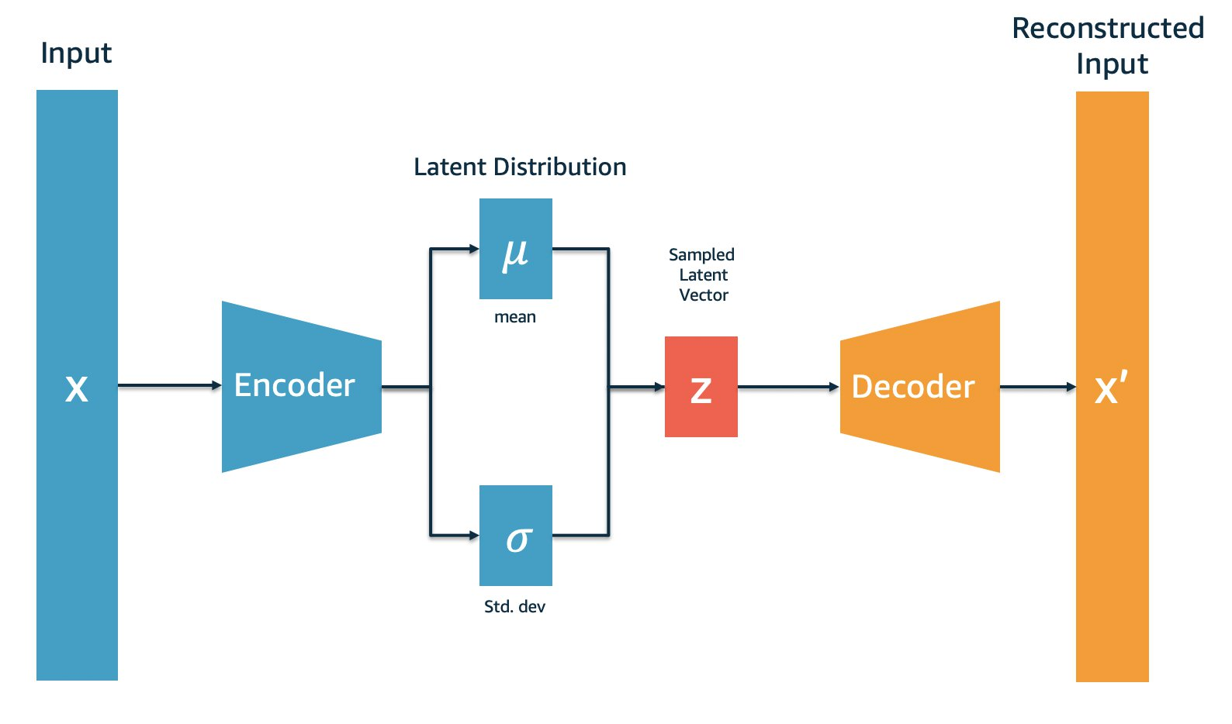
Variational Autoencoder
VAE introduces probabilistic elements into the encoding-decoding process

Slide 21








Anomaly Detection using Autoencoder
Training
Testing
Autoencoder
(Sparse or Variational)
Autoencoder
(Sparse or Variational)
Clean Data with no anomalies
Reconstructed
Data
Test Data with
anomalies
Reconstructed
Data
Reconstruction Error
Reconstruction Error
Low Pass Filter
Compare against
threshold
Normal
Data
Anomalous
Data
Calculate Threshold
Note : We flag the failure period as well as a period of 24 hours before the period as anomaly to ensure that we feed
absolutely clean (normal) data to the autoencoder during training

Slide 22
Online Learning
Given there is a continuous flow of data, the model is expected to update itself continuously such that it is trained on all the normal data available till date
In this particular online learning procedure, the model is trained in a predetermined time window and predicts the anomalies in a subsequent test time window.
First occurrence of failure
Iteration 1
Feb
Mar
Apr
May
Jun
Jul
Aug
Train
Test
First occurrence of failure
Feb
Mar
Apr
May
Jun
Jul
Aug
Iteration 2
Train
Test
First occurrence of failure
Iteration 3
Feb
Mar
Apr
May
Jun
Jul
Aug
Train
Test
First occurrence of failure
Feb
Mar
Apr
May
Jun
Jul
Aug
Iteration 4
Train
Test

Slide 23
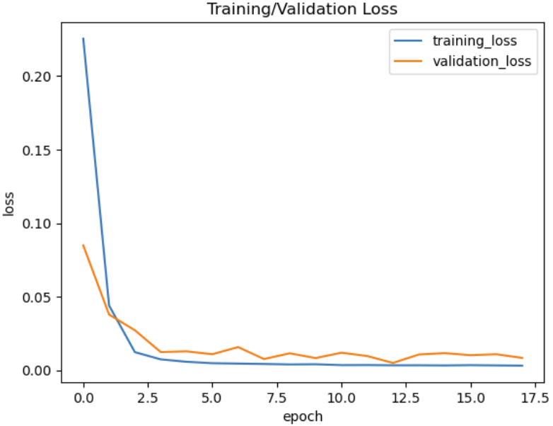
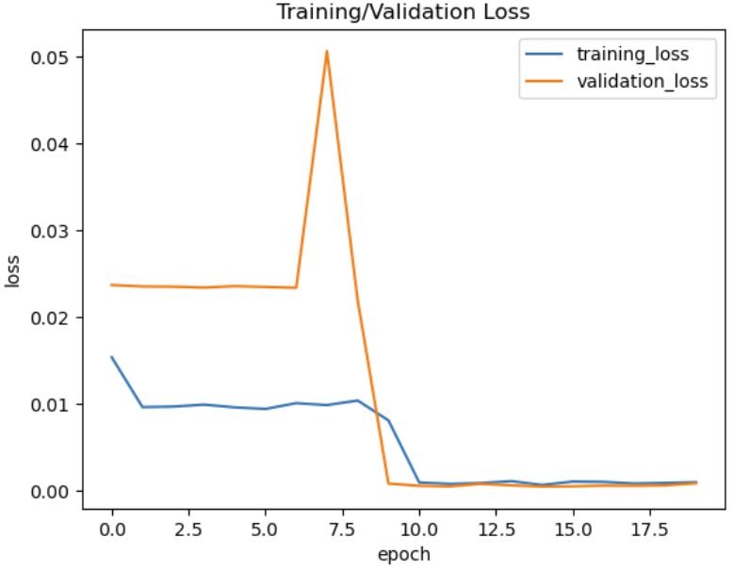
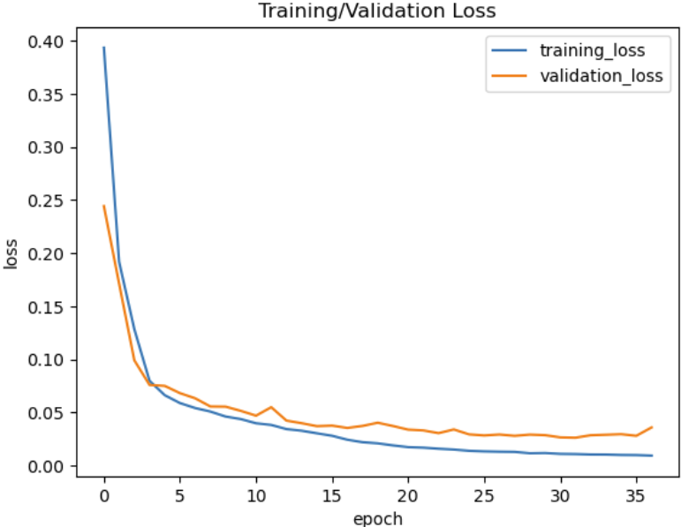
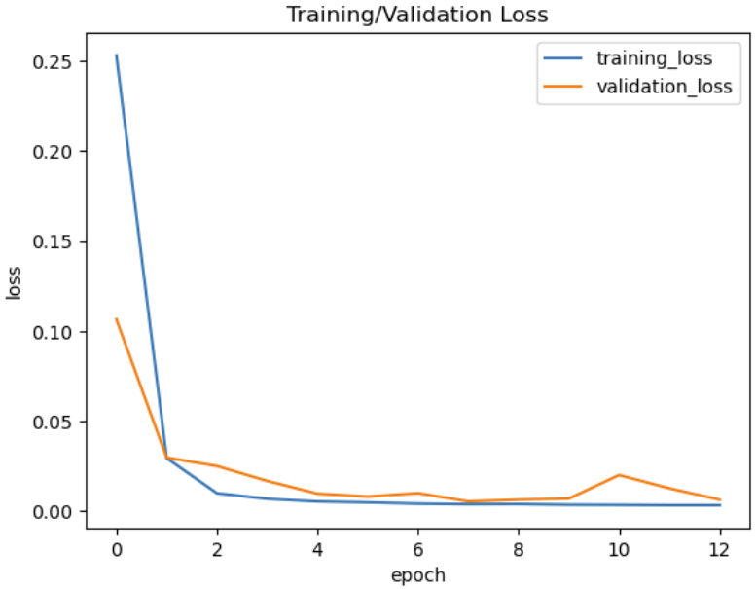
Reconstruction Loss: SAE vs VAE & Analog vs Digital
SAE
VAE
Digital
Analog
Overall, the digital signals, lead to better reconstruction loss. SAE leads to better reconstruction for digital signals while VAE leads to better reconstruction for analog signals

Slide 24
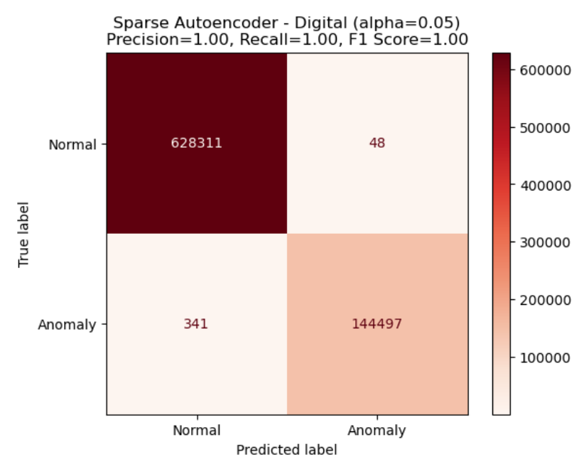
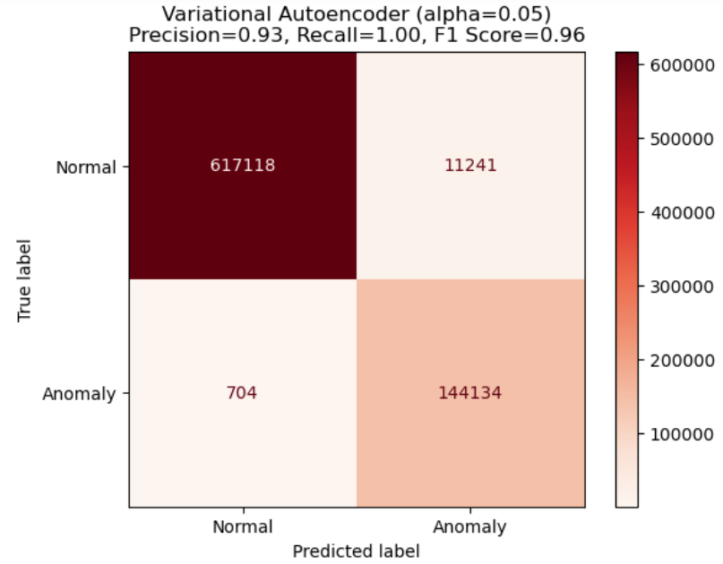
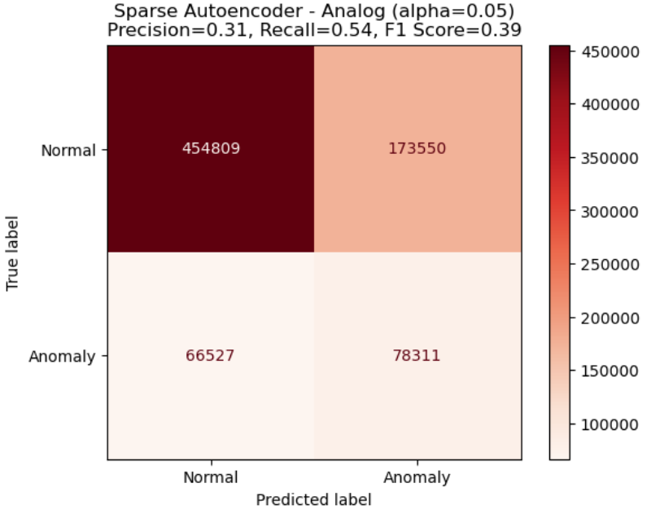
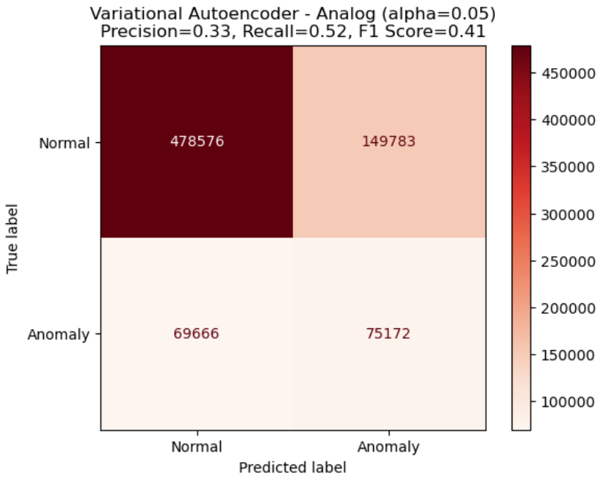
Results – Iteration 1 Train – Till the first occurrence of failure | Test – Remaining data till the end of July
SAE
VAE
Digital
Analog

Slide 25
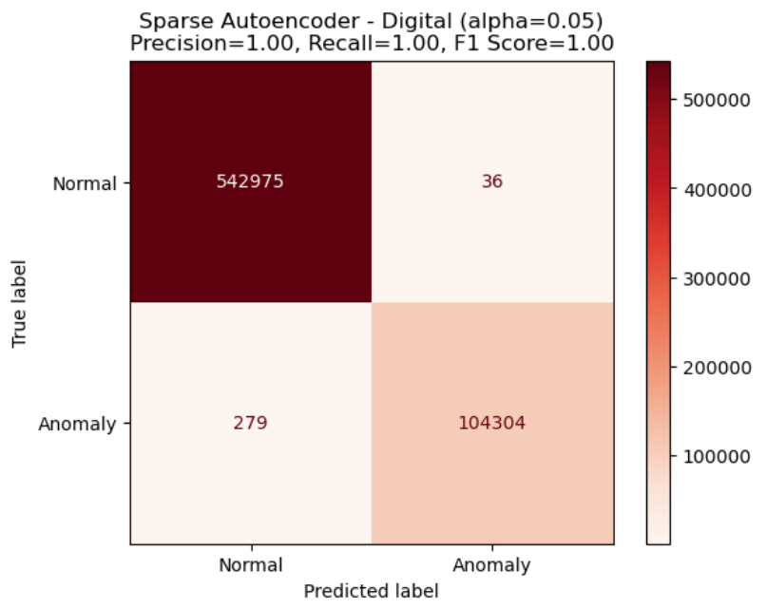
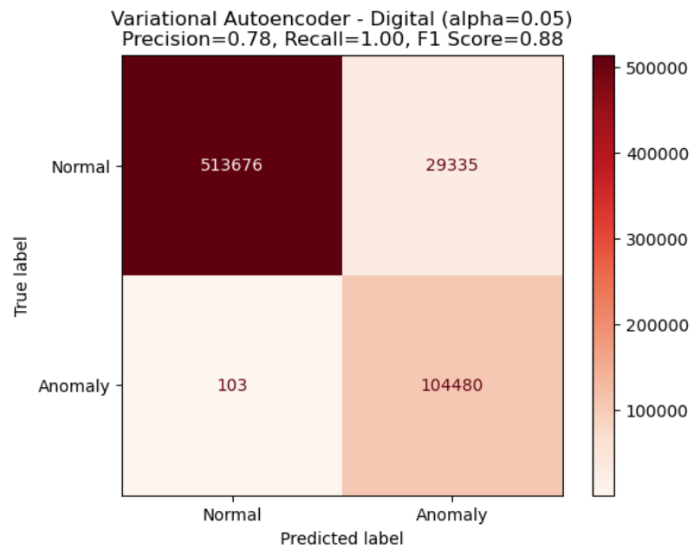
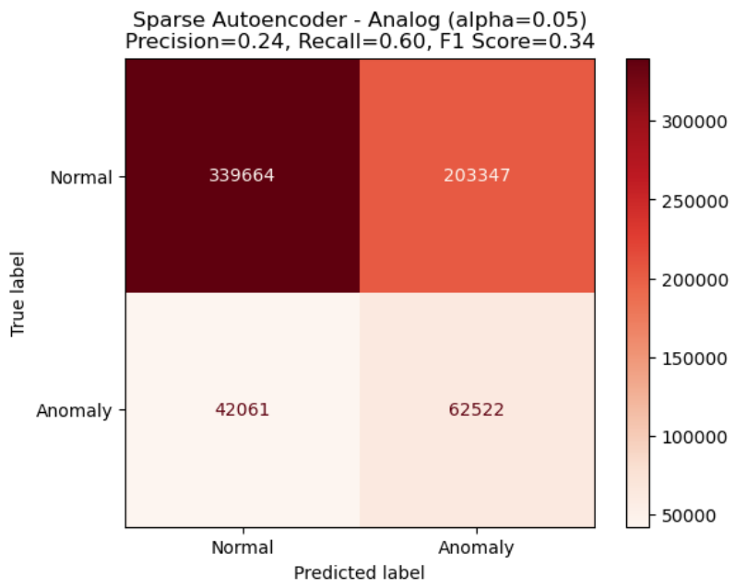

Results – Iteration 2 Train – Till April End | Test – Remaining data till the end of July
SAE
VAE
Digital
Analog

Slide 26
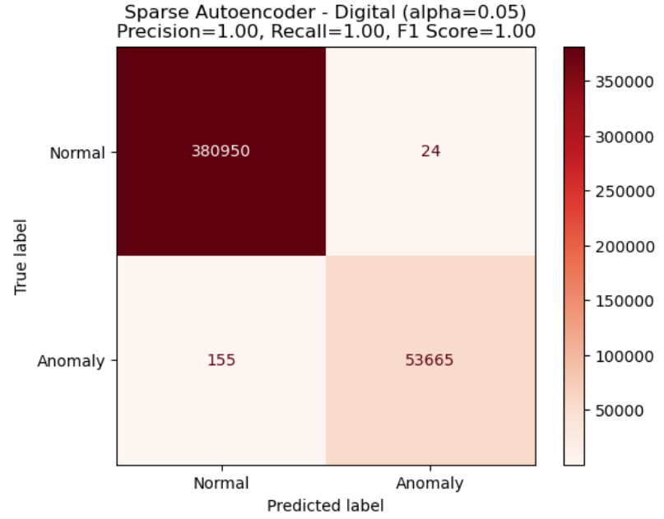
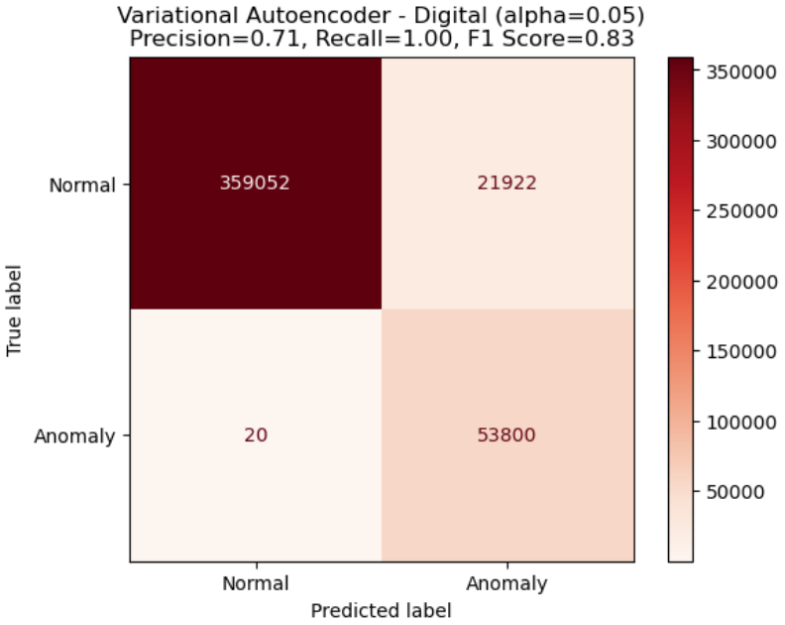
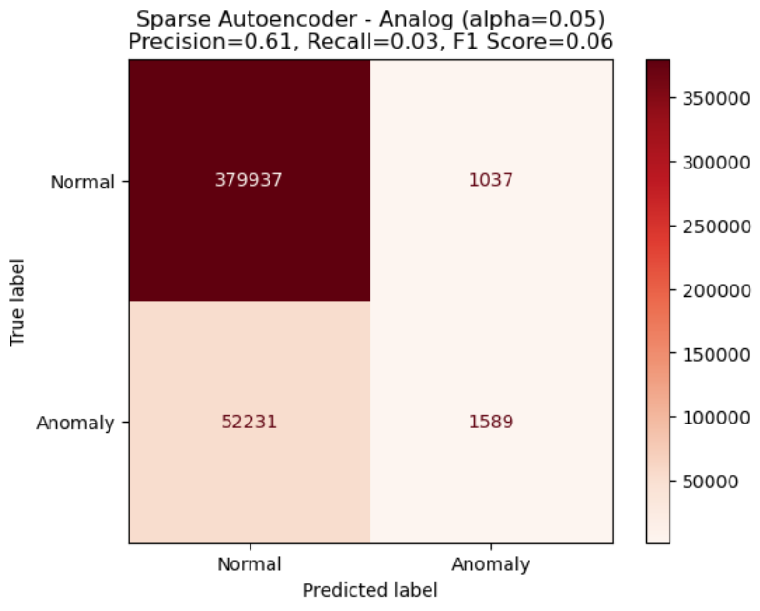

Results – Iteration 3 Train – Till May End | Test – Remaining data till the end of July
SAE
VAE
Digital
Analog

Slide 27
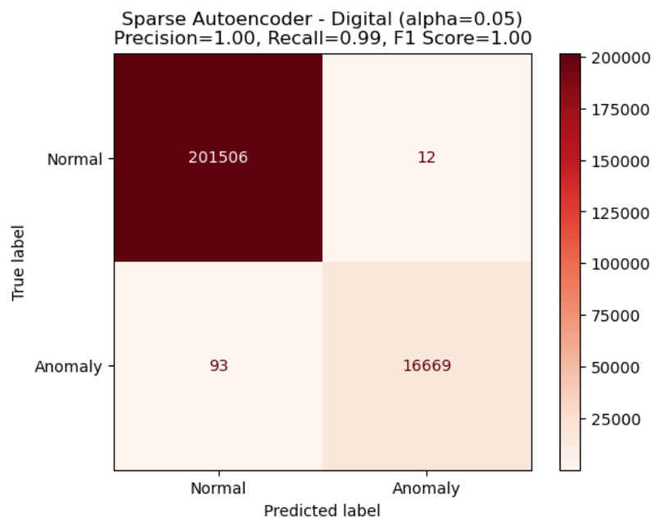


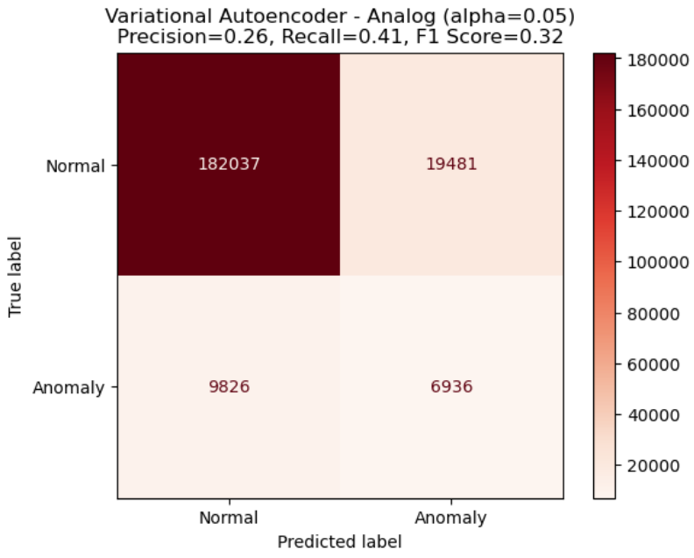
Results – Iteration 4 Train – Till June End | Test – Remaining data till the end of July
SAE
VAE
Digital
Analog

Slide 28
Results – Summary
Sparse Autoencoders work best on this data as indicated by almost perfect precision and recall period after period
Data from digital sensors are more useful in predicting anomalies in comparison to analog sensors

Slide 29
06
Next Steps

Slide 30
Next Steps
Additional pieces to explore:
Given a signal, how long is the unit going to run without breaking down?
Possible techniques:
LSTM – initial steps
Transformers
Vanilla – longer term
Informer – temporal
SpaceTimeFormer – spatial and temporal
Autoformer – seasonal decomposition
Causal inference between the sensors?
Causal forest
Survival Analysis

Slide 31
THANK YOU

Slide 32
Appendix

Slide 33
Anomaly Detection using Autoencoder
Training Data
(Normal)
Testing Data
(With Anomaly)
The model learns to encode and decode normal patterns, capturing the essential features
Once the autoencoder is trained on normal data, it is used with the test data which includes both normal and abnormal data
Instances with reconstruction errors surpassing the threshold are considered anomalies
Autoencoder Training
Calculating Reconstruction Error
Defining Threshold for each feature
Model
Calculating Reconstruction Error
Anomaly Detection
(Comparing with Threshold)
Anomaly
Normal

